Slide 1
IBM and Misa Canada(Ontario) Memorandum of Understanding and MRM V2 Workbench Pilot
December 1, 2010
IBM and MISA Discussion (December 3, 2010)

Slide 2
MISA Working Group required to provide a Status report to the Steering Committee within a couple of weeks need clear directions and options at that time.
MRM V2 Pilot Status (Jim Amsden and Alison Oleksiak)
  Preparation for the pilot
  Pilot duration and support
  Exhausted the initial funding that was raised for the MRM project.
  Need an idea of what we will need for the next 6-12 months
Software License Status (Doug Mester and Bruce Baron)
  Ralph has heard that access to download System Architect through Passport Advantage is contingent on our having paid the outstanding maintenance fees for the previous IBM software.
  We also understand that IBM has agreed internally to swap out the existing licences for an appropriate number of SA licences
    How many licences and for which products?
    Impact to the maintenance fees noted above.
MRM V2 Production Delivery Platform (Alison Oleksiak and Rodney Joyce)
  Geovanni attended a session on IBM’s cloud computing platform and plans for Canada and is thinking that this might well provide a good solution for the MRM and might even replace our e-Solutions platform, which is also coming up for renewal.
  Is this an option? What might it cost?
  How would this option impact the product licensing decisions?
IBM and MISA Business Arrangement
  IBM Software Group (Bruce Baron and Doug Mester)
  IBM SmartCity Initiative (Bob Dill and Peter Williams)
  IBM Cloud (Rodney Joyce and Municipal Cloud Team)
  IBM Research (Mike Kearney and Bob Schloss)

Slide 3
MRM V2 Pilot Update
Initial Proof of Technology
Sept 2009: IBM and MISA sign MoU (Sept 2009)
Nov – Mar 2010: Initial Proof of Technology (PoT) definition, build, config and evaluation
Apr-May: MISA MRM WG consolidate information on experience and challenges on the initial PoT
Jun-July: IBM Team evaluate workbench alternatives based on revised requirements
Aug: IBM presents 3 alternatives to the MISA MRM Working Group
MRM V2 Pilot
Sept: MISA Steering Committee agreed to proceed with the System Architect workbench
    alternative
Sept - Nov: Joint IBM/MISA team (Skip & Jim) refine MRM V2 Meta Model and Workproduct List.
      IBM migrate previous PoT effort and develop new workproduct templates.
Dec/2010: MISA Team launching the MRM V2 Board and Terms of Reference
Dec/2010: Region of Peel Pilot
      Jim to work with Geovanni’s team to install and Configure Peel & eSolutions environment
      Jim to provide draft document of installation instructions
      Roy developing the Test Script
      Geovanni to develop Governance Terms of Reference for the 6 week pilot including weekly Checkpoint meetings for change management of baseline environment (see next page)
      Geovanni’s team to attend recommended education for System Architect
Jan/2011: Region of Peel to execute the 6 week pilot (Jan-Feb)
Feb/2011: Pilot report back and go-forward strategy

Slide 4
Conceptual Model
Municipal
Reference
Model (MRM)
V2.?
Meta Model
Municipal
Reference Model (MRM) V2
Business Model V?
(Description of Program, Services, Resources & outcomes of a City/
Community)
My Municipal or
My Program
Business
Reference Model (s)
(Description of program,
Services, outcomes &
resources within selected
communities)
My Municipal or
My Program
Information &
Data Sources
(Variety of Data Sources
includes historical,
operational and real-time
MISA Business
Model
Workbench
(SW tools used to capture, model and visualize the business reference model (e.g. My Municipality)
MISA Strategy &
Planning
Workbench
(SW tools or scripts
used to support
Strategic and Operational
Planning by IT and City Planners)
MISA Community Collaboration & Asset Mngt
Workbench
(SW tools used to manage the models created by each municipality & other useful assets)
MISA Community
(Municipal)
Services
Workbench
(Future)
(Platform for the hosting and delivery
of shared services within a community (municipalities, , agencies, individuals & business)
Information & Technology Delivery Platform
(Delivery platform to support strategy & planning services across
Municipalities & Communities)
(Future: Virtualized, Subscription Based, Usage Tracking, Provisioning)
Information Sources

Slide 5
Baseline Assets
 | Owner | Author/ Editor | Authoritative Source | MRM V2 (Change Log) | Notes
MRM V2 Meta Model | MISA | Alan Mitchell (KPMG) | Word document (file name & version?) |  | IBM has made some changes and additions that need to be aggregated together and reviewed and agreed to.
MRM V2 Reference Model | MISA | Alan Mitchell (KPMG) | Excel Spreadsheet Word document (file name & version?) |  | IBM has made some changes and additions that need to be aggregated together and reviewed and agreed to.
MRM V2 Use Cases |  | Alan Mitchell (KPMG) | Word document (file name & version) |  | IBM has made some changes and additions that need to be aggregated together and reviewed and agreed to.
MRM V2 System Architect Encyclopedia | IBM | Jim Amsden (IBM) | NA
MRM V2 System Architect Workproduct Templates & Reports | IBM | Jim Amsden (IBM) | Word document
Peel MyMunicipality Baseline Business Model | Region of Peel
Use Cases and Test Scripts | Region of Peel

Slide 6
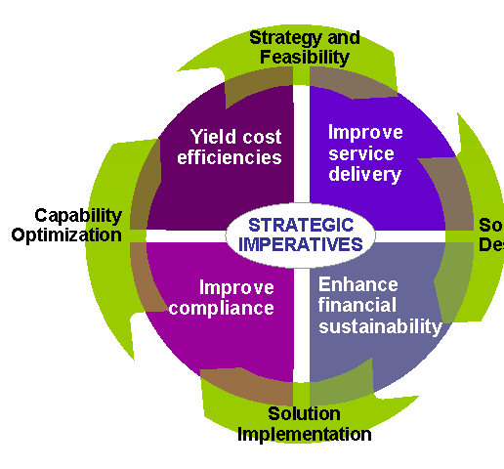
Five mutually-reinforcing strategic imperatives to improve efficiencies
Put client at the center
Putting the client at the center of your service delivery system means organizing the services you offer, and the way you offer them, around the needs of the client rather than around organizational or programmatic boundaries.
Improve client outcomes
Improving client outcomes means moving away from a transaction-oriented system toward an ongoing relationship with a client, in which the focus is on achieving sustainable client outcomes.
Enterprise
System
Target services effectively
Targeting services effectively means applying scarce resources more thoughtfully, with an eye toward maximizing their value to both clients and taxpayers.
Integrating service providers means sharing appropriate information and collaborating with community groups and other providers in developing and delivering services to clients.
Integrate service providers
Service strategy and supporting information systems should be planned in concert to optimize resource use and achieve efficiencies.
Increasing efficiency means reducing the cost of successful outcomes—the unit cost of a program—by streamlining business processes, automating routine transactions, and focusing workers on higher-value activities.
Increase efficiency

Slide 7
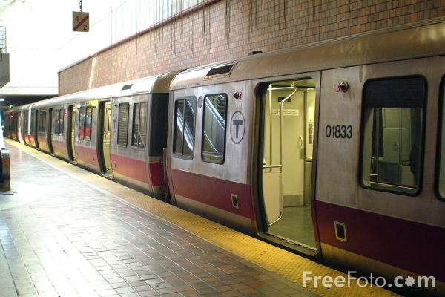

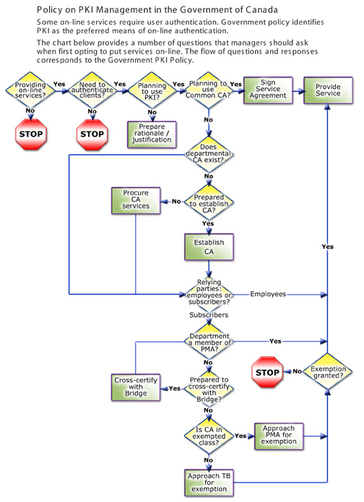

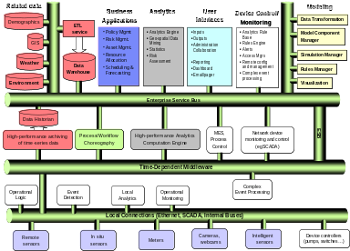
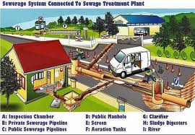

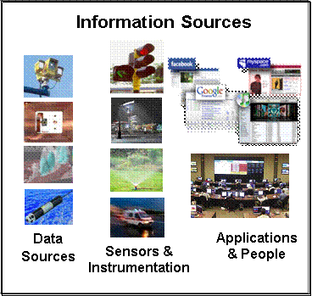
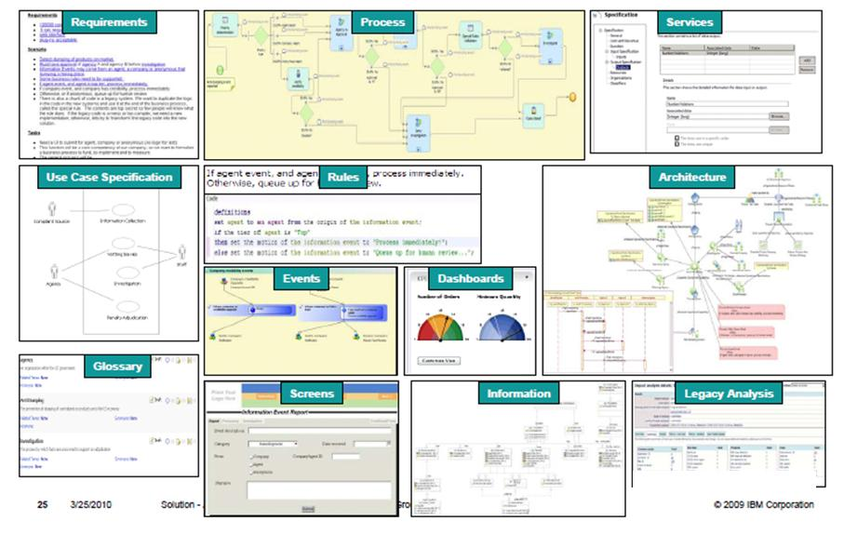
The world as we know it
People
Policy &
Process
IT Assets
Physical Assets
Models
Smart Principle

Slide 8








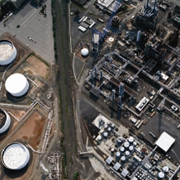



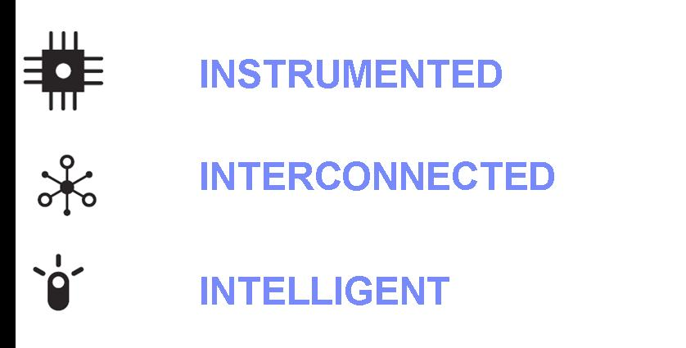
The Smart Principle: Accumulating real-world data contains valuable information about patterns of behavior that can be used to support the planning and operation of services in support of the community and the environment
Traffic & Road systems
Water Operations (Hydro & Ground)
Community Engagement
Supply chain Models
Commuter Patterns
Demographics
Building Management
Energy & Resource Management
Construction & Infrastructure Projects
Environment Impacts
Port Activity & Management
Weather Patterns

Slide 9


IBM SmartCities Vision
Smarter Cities Command and Control
Smarter Cities Subsystems
Citywide Situational Awareness
Tactical and Operational Control of City Infrastructure Subsystems
Events
Alerts
Incidents
Response
Aggregated data from subsystems for citywide operations, planning, & collaboration
  Common operational view
  Cross-City situational awareness, status, and control (incident management)
  Trend and analysis prediction
  Simulation and investigation
  Process optimization
  Sensor based data collection
  Legacy integration
  Correlation and filtering
  Real-time & predictive analytics
  Automated actions
  Incident collaboration
Automate and manage service sub-systems to create a collaborative environment that enables a city’s core systems to become smarter and support city decisions:
      Collect, Filter and Manage the Right Kind of Data
      Integrate, Analyze and Operationalize the Data
      Optimize Citywide Systems to Achieve Desired Behavior

Slide 10
MISA and IBM Business Understanding Discussion
Upcoming Events
  Jan 2011: Municipal Cloud exploration
  Feb 2011: Federation of Canadian Municipalities (Victoria, BC) Conference
  April 2011: IBM Urban Information Symposium
  May 2011: CAMA Conference and Annual General Meeting (Halifax, Nova Scotia)
  June 2011: MISA (Ontario) Conference (Peel Region)
  June 2011: Lac Carling (Niagara Canada)
  Sept 2011: MISA West, Vancouver area
  Sept 2011: MISA East - RIMQ (Montreal or Quebec)
Research and Innovation
  Industry Plug-ins and Software Industry Solutions
  Industry SmartCities Challenge
  IBM Actionable Business Architecture
  IBM Urban Information Symposium
  Research
    Collabatory
    First of a Kind

